Slide 1
The process of UX design
Ms. Iqra Shahzad
Department of Software Engineering, NUML, Islamabad.

Slide 2
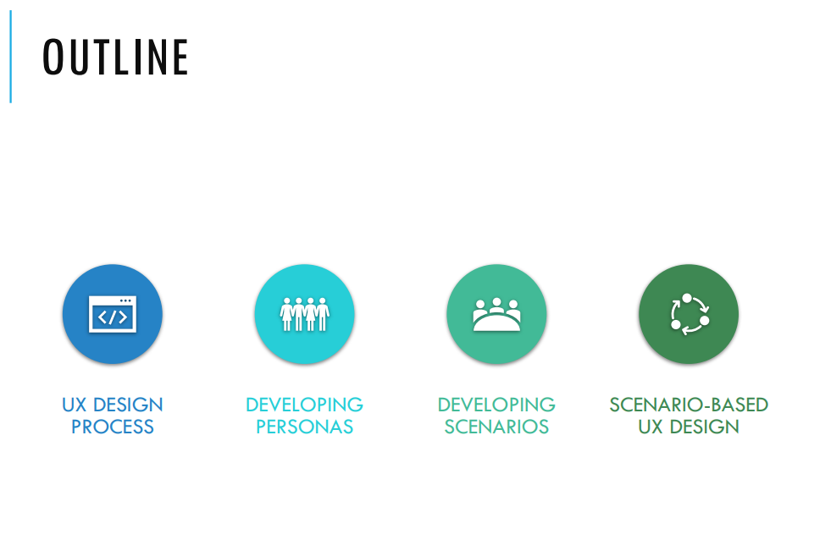

Slide 3
UX design process
A UX design process is a series of steps that designers take to turn an idea into a user-friendly interface. The steps may vary depending on the project.
Typically includes:
Step 1: Define
Step 2: Research
Step 3: Analysis & Planning
Step 4: Design
Step 5: Prototyping
Step 6: Testing
Step 7: Launch
Step 8: Iteration
Notes:
The UX design process is important because it helps designers create interfaces that meet the needs of their users. By following a well-defined process, designers can be sure that they are covering all of the necessary bases and creating an interface that will be user-friendly and effective.

Slide 4
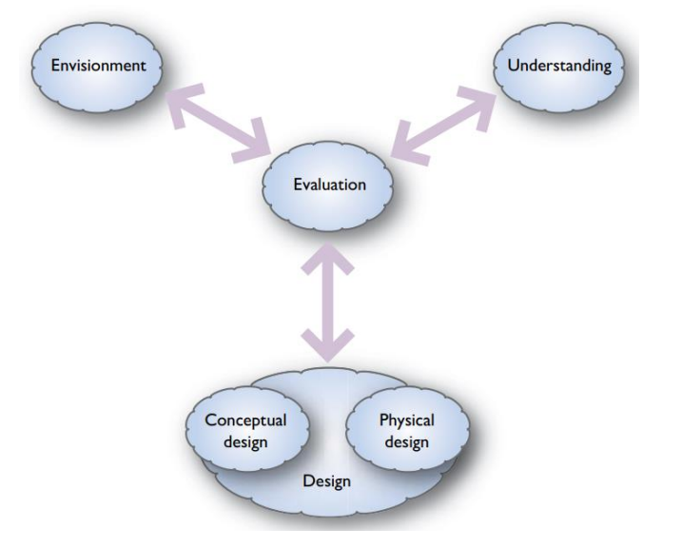
Design process

Slide 5
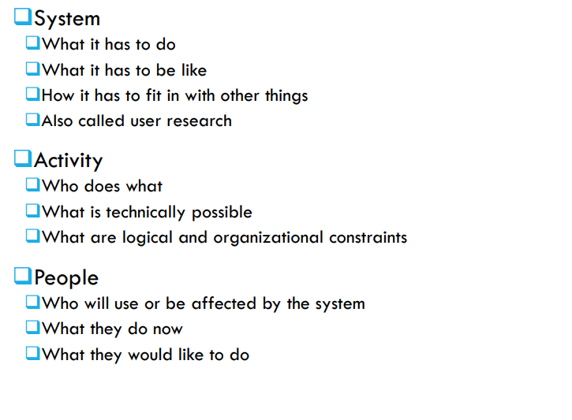
Understanding
(Users and their tasks)
Technology what is compatible and fesible
(Users and background)

Slide 6
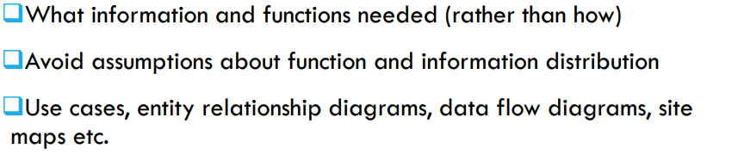
Conceptual design
In UX design process , a conceptual model provides a mental framework that users rely on to predict and understand a system's functionality.
It bridges the gap between user expectations and the product's functions,
For instance, Apple’s iPhone interface seamlessly embodies conceptual design, prioritizing user-friendly navigation and aesthetic appeal. The development of such a design could be influenced by a technical design authority, which defines and ensures adherence to technical standards and practices.

Slide 7
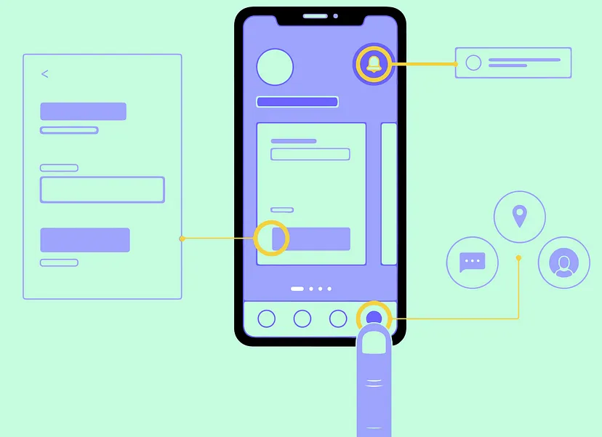

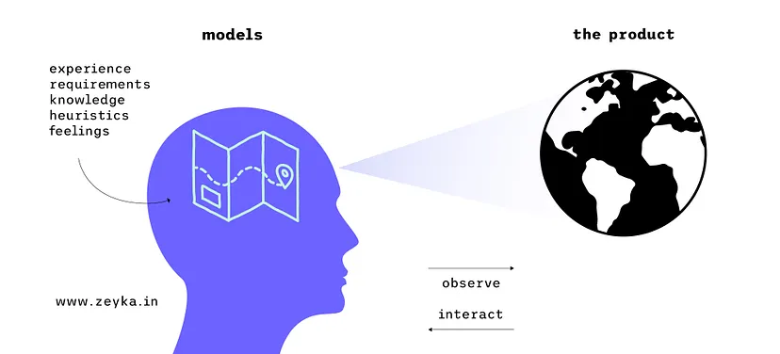
Examples

Slide 8
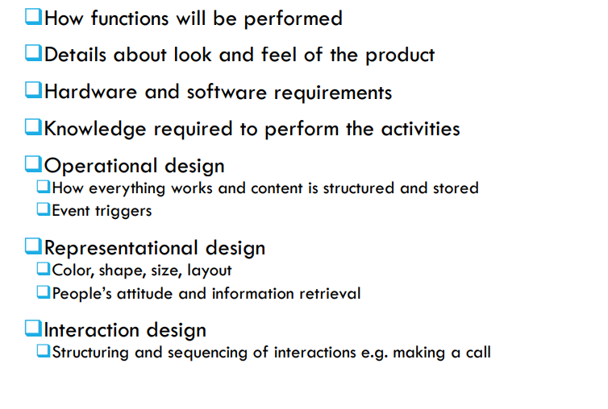
Physical design

Slide 9
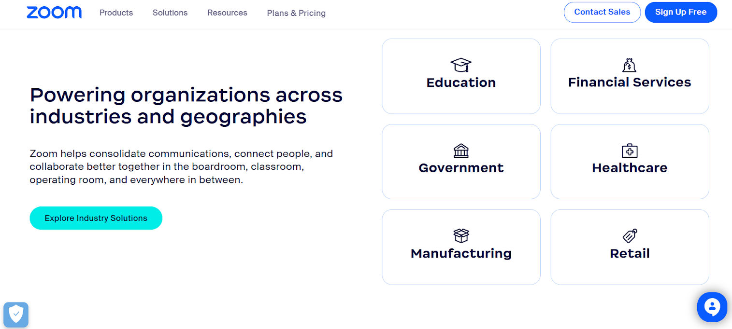

Slide 10
Envisionment
Envisionment is standard to effective human-centred design, to enable designers to compare from other people's perspectives and to explore design concepts and ideas with others
Basic techniques
Sketches and snapshots(quickly visualize the idea)
Storyboards(using a simple cartoon-like structure, key moments from the interactive experience are represented.)
Mood boards
Navigation maps
Navigation maps focus on how people move through the site or application. The aim is to focus on how people will experience the site.
Wireframes
prototypes

Slide 11
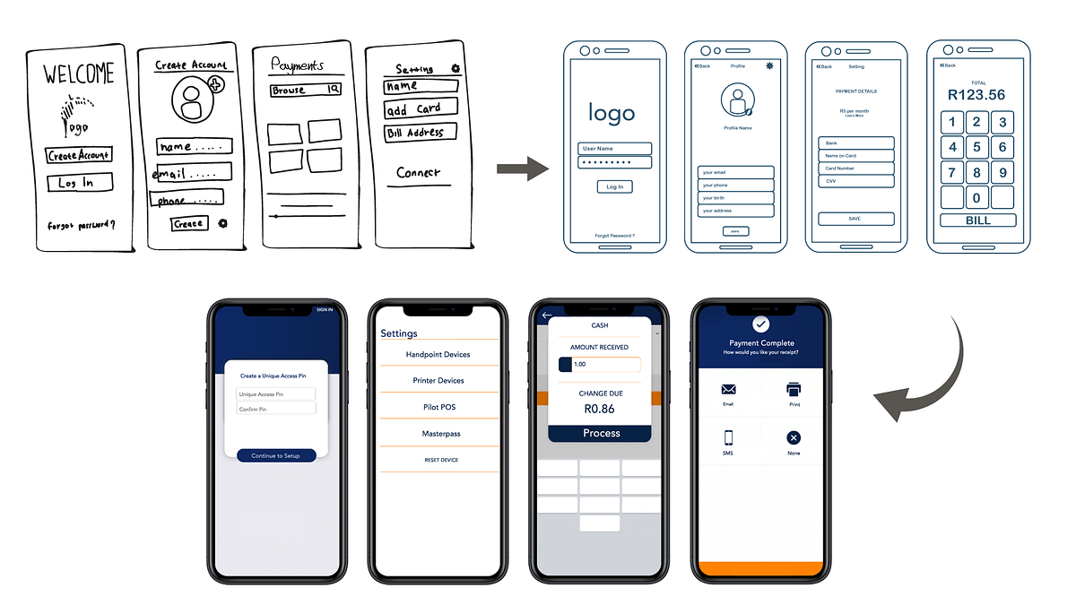
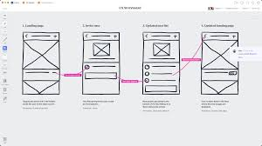
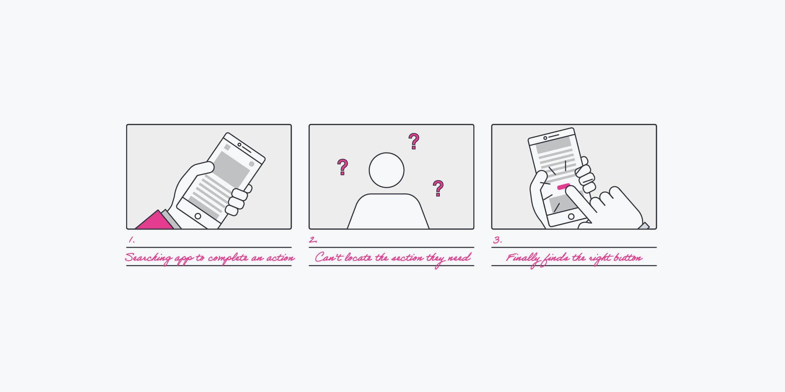

Slide 12
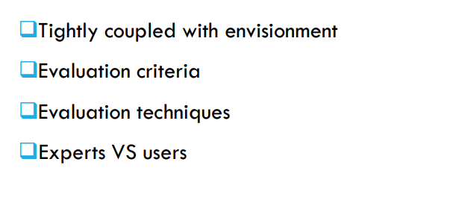
Evaluation
keep in mind that successful UX design requires ongoing evaluation, testing, and refinement to ensure alignment with user expectations

Slide 13
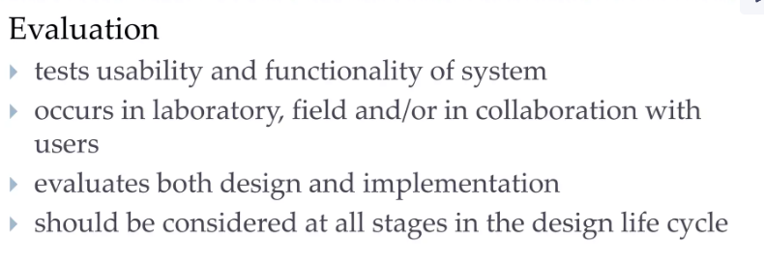
Evaluation techniques

Slide 14
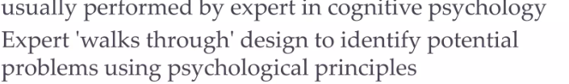
Cognitive walkthrough:

Slide 15
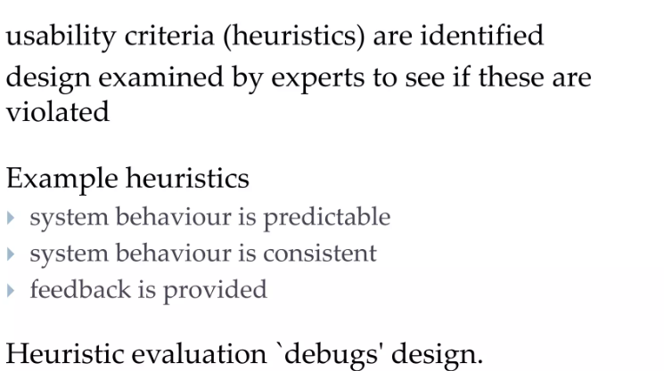
Heuristic evaluations:

Slide 16
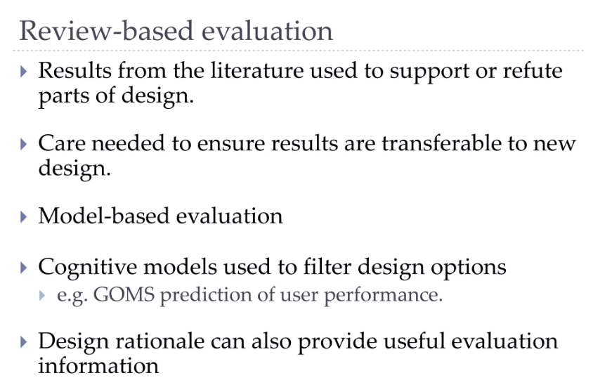

Slide 17
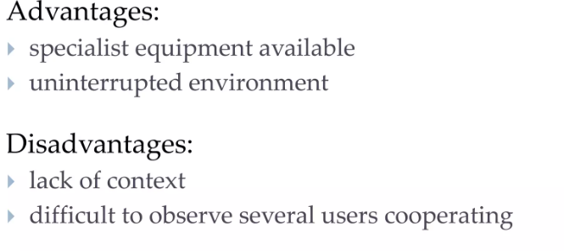
Laboratory studies
Field studies

Slide 18
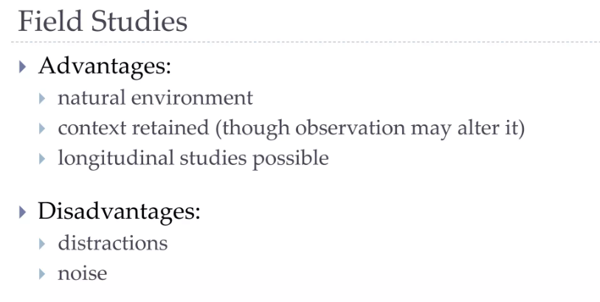

Slide 19
Think Aloud
• user observed performing task
• user asked to describe what he is doing and why, what he thinks is happening etc.
• Advantages
– simplicity
- requires little expertise
– can provide useful insight
– can show how system is actually use
• Disadvantages
– subjective
– selective
– act of describing may alter task performance

Slide 20
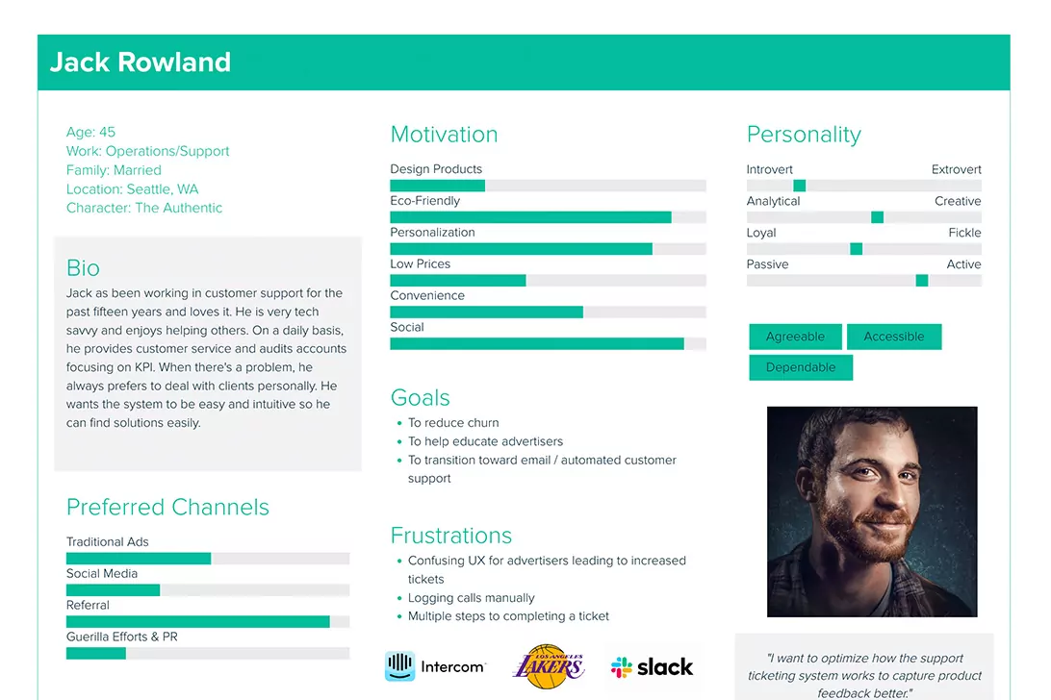
Personas
Personas are descriptions of individual people who represent groups of users that would interact with your system. You use them to guide your design

Slide 21
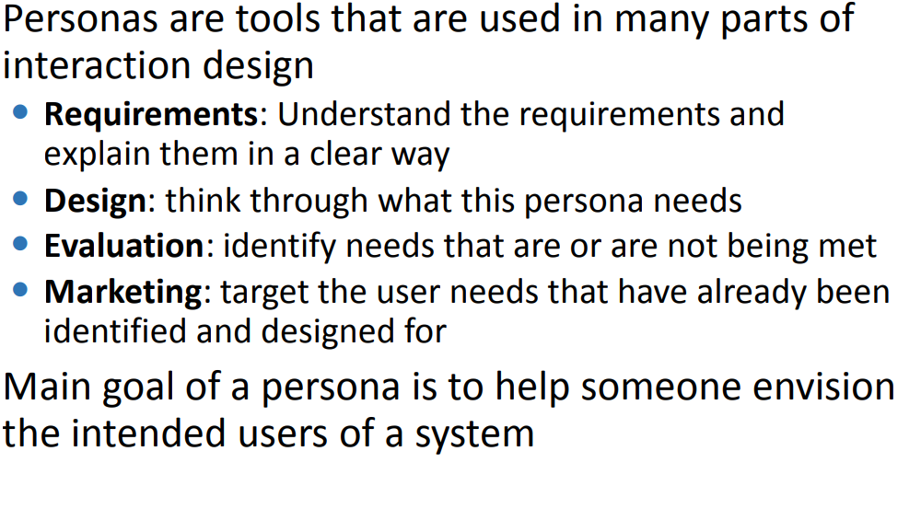

Slide 22

Objective of personas
The objective of a persona is to examine the process and workflow that your user would prefer to utilize to achieve their goals in interacting with your product or service.
It focusses on: What does my typical user want to do with my product?

Slide 23
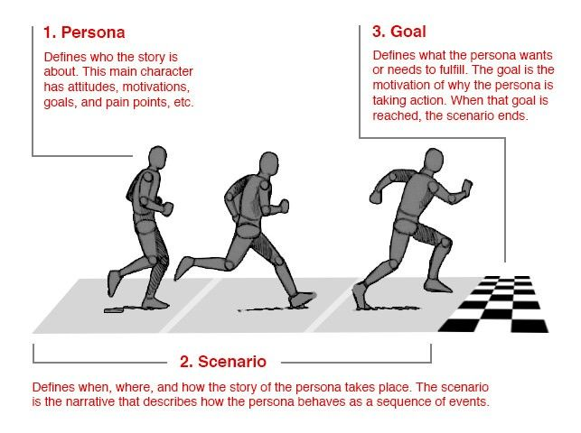

Slide 24
How do you create user personas
To create user personas and scenarios, you need to conduct user research and analysis.
You need to collect and synthesize data from various sources, such as interviews, surveys, observations, analytics, and feedback.
You need to identify and segment your user groups, and select the most relevant or representative ones for your project.

Slide 25
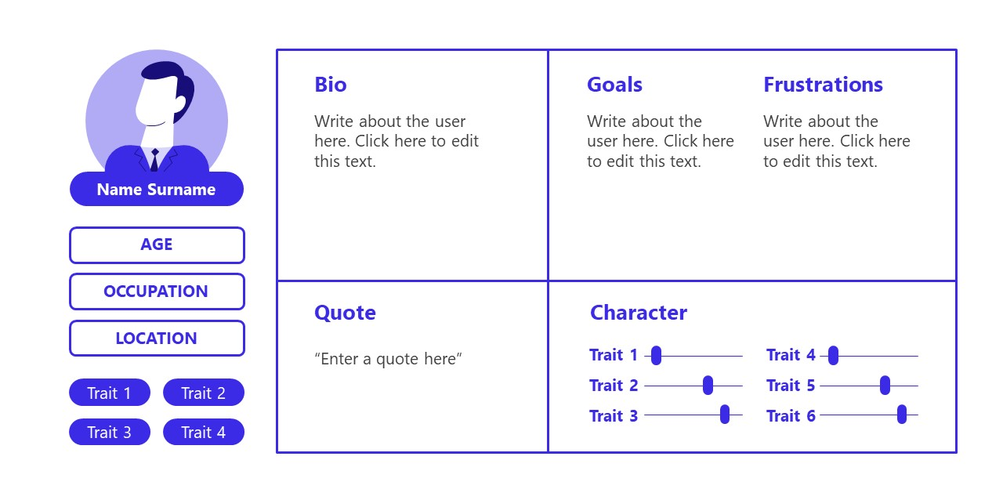
Scenario

Slide 26
Activities
Activity 1
You are creating a website that deals with properties. People should be able to buy and sell properties with the help of your website. Your website should ideally include information that can help people make the decision. Create Persona for a user who has to buy a house but has no previous experience buying or selling properties.

Slide 27
Solution:
Name: Fatima Ali Age: 38
Marital Status: Married
Fatima Ali has always dreamed about owning a house. Recently with the promotion of her husband Ali Javaid her dream can finally be turned into a reality. The main problem for her now is she has no idea where to start. She is not sure what kind of factors would go into the price. She knows what kind of house she is looking for but knows nothing about the property marker. Ali is too busy with his job to think about these things and has left it all to his wife.
She would like a website which gives her all the information that she needs in one place without drowning her in information. She is quite comfortable with online shopping but this is a big decision and she wants to make the right choice.
It is very important for her to know about what kind of areas or neighborhoods are undesirable. Another factor that is important is that she wants to live in a quite area with good schools and parks for her 3 year old twin girls.

